Slide 1
MYSTerious WoC Lero Hackathon 2022
Mohamed Seliem, Yashwant Dhurde
& Srikanth Tiyyagura

Slide 2

Motivation
Investigating the female contributions in the World of Code.
Fact caught our attention about @takagotch:
Oldest contribution dates to Jan 2018 with 167 Projects.
Some numbers: 10888 Projects, 45663 Commits, and 81958 Files…… Written in Ruby, Perl, Typescript, Python…..
Our motivation is to shed more lights on the female role and attract more to join the coding herd.

Slide 3
Research Questions
Q1) Identify the female authors in WoC and their interests in terms of programming languages and Project Themes?
Complimentary: Compare to the whole authors interests to avoid common interests in the public.
Q2) Identify the ethnicity of female authors to create a heat map of where the most developers are located/based and any region specific initiatives that helping them ?

Slide 4
Author Metadata Sample
mongos> db.A_metadata.U.findOne({'Gender':'female' })
{
"_id" : ObjectId("629002b5d7d46b4d9632d481"),
"FileInfo" : {
"Python" : 14,
"other" : 83,
"Perl" : 2,
"Sql" : 3,
"JavaScript" : 1,
"Java" : 8,
"C/C++" : 22
},
"NumActiveMon" : 14,
"EarliestCommitDate" : 1596735100,
"Gender" : "female",
"LatestCommitDate" : 1632834097,
"MonNprj" : {
"2021-07" : 3,
……
"2021-04" : 1
},
"NumOriginatingBlobs" : 682,
"AuthorID" : "Nivedhitha D <50760049+nive927@users.noreply.github.com>",
"MonNcmt" : {
"2021-07" : 7,
"2021-04" : 48
},
"NumProjects" : 23,
"NumCommits" : 515,
"NumFiles" : 133
}

Slide 5
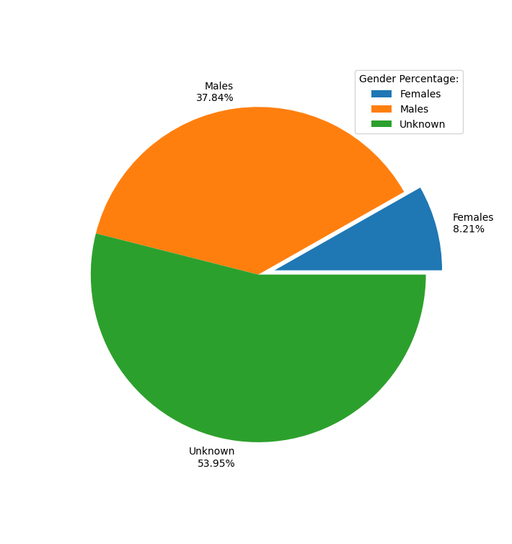
Gender Distribution
mongos> db.A_metadata.U.distinct('Gender')
[ "female", "male" ]
mongos> db.A_metadata.U.count()
39,994,754 -> 40 million
mongos> db.A_metadata.U.count({'Gender':'female'})
3283682 -> 3,283,682 million -> 3.2 million

Slide 6
Drilling the Female Authors Data
mongos> db.A_metadata.U.count({$and: [ { NumCommits:{$gt:10} }, {'Gender':'female'} ]})
1460090 -> 1.46 million (Number of Commits > 10)
mongos> db.A_metadata.U.count({$and: [ { NumProjects:{$gt:1} }, {'Gender':'female'} ]})
1807634 -> 1.8 million (Number of Projects > 1)
mongos> db.A_metadata.U.count({$and: [ { NumProjects:{$gt:10} }, {'Gender':'female'} ]})
338290 -> 338 thousand (Number of Projects > 10)

Slide 7
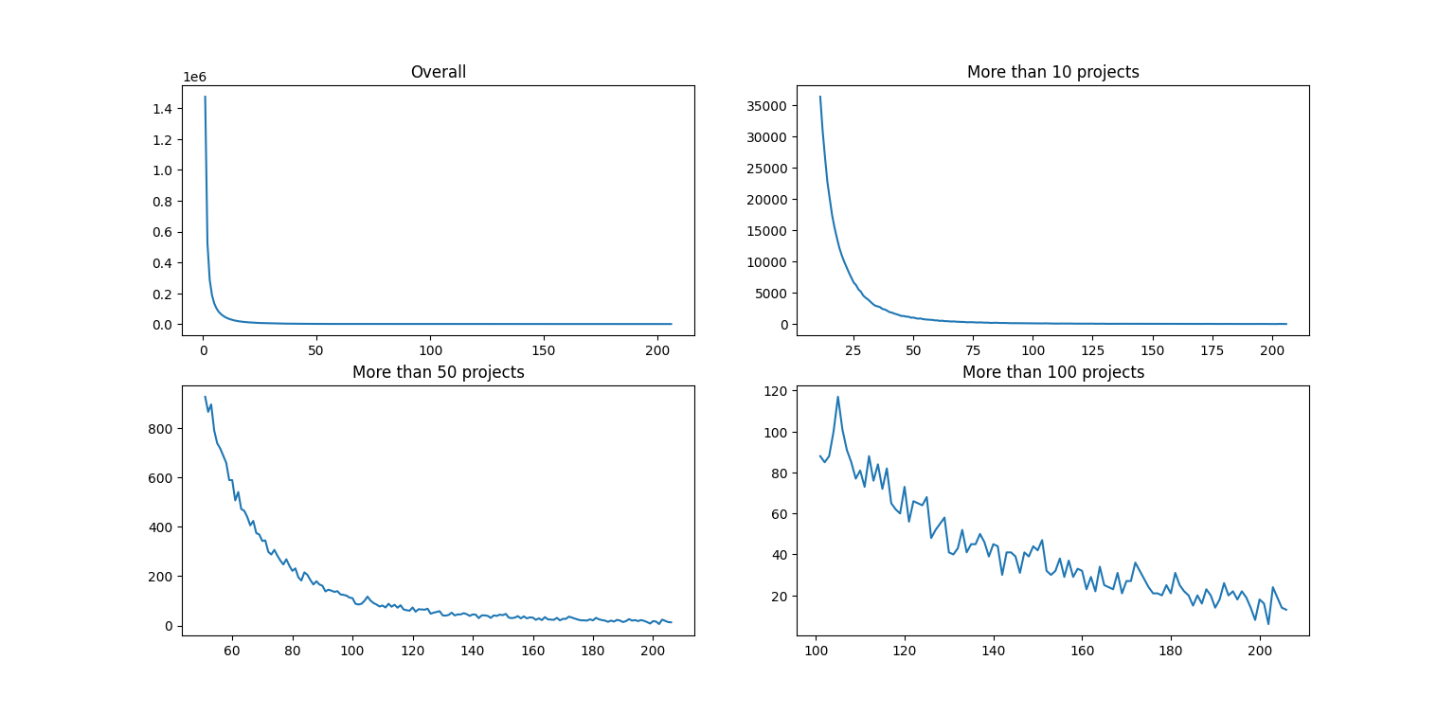
Insights of number of females/Projects

Slide 8
Preliminary findings

Slide 9
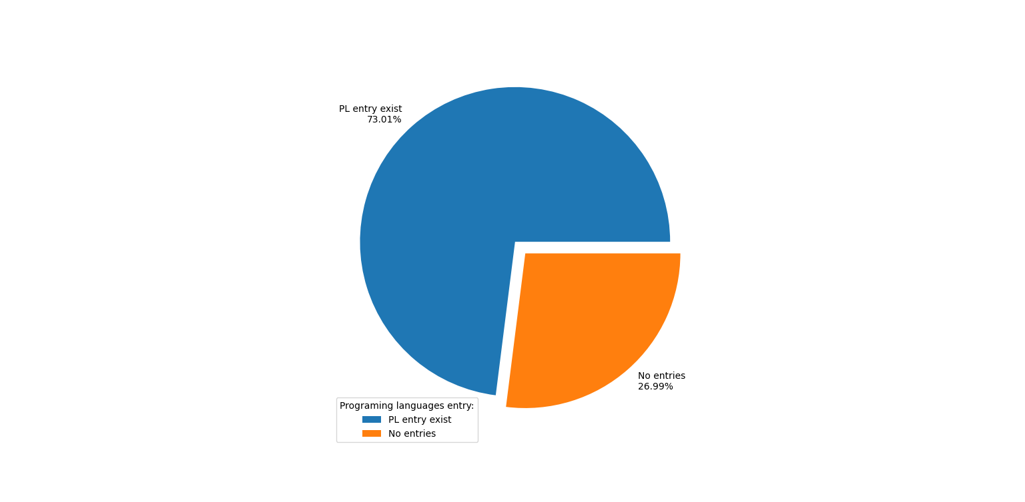
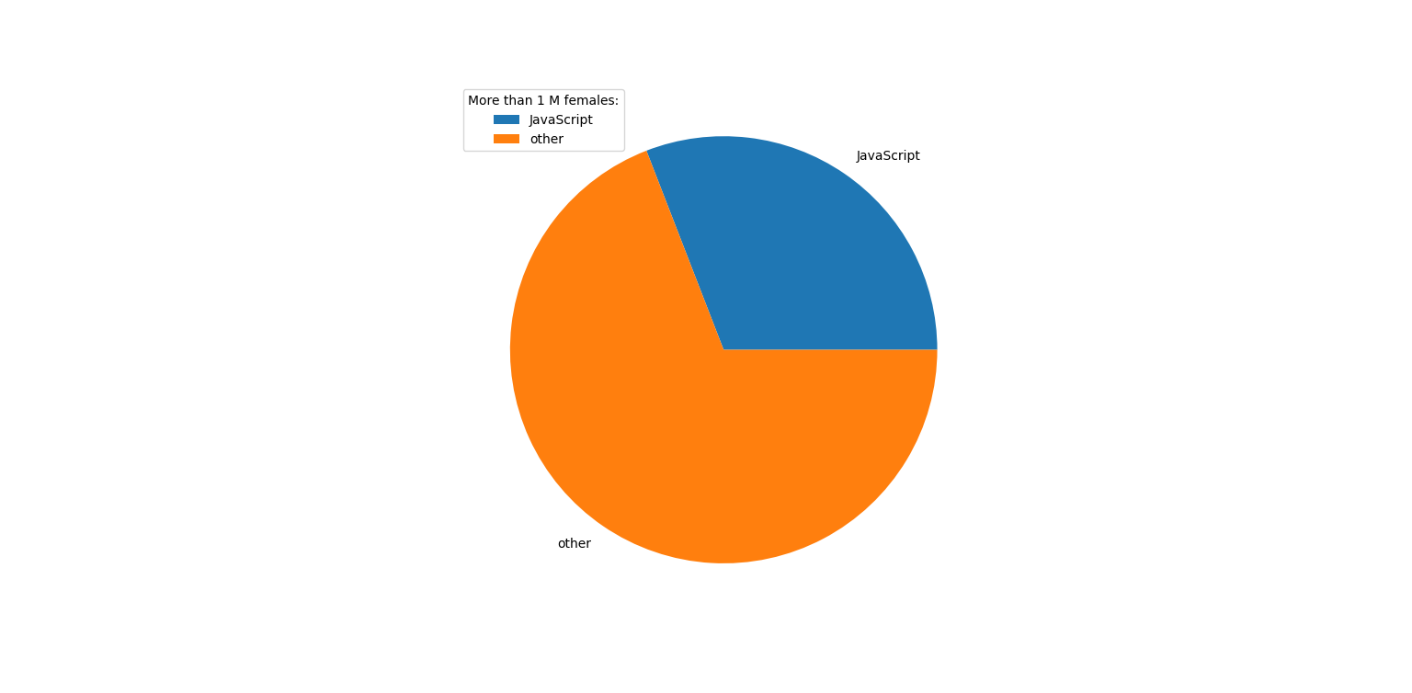
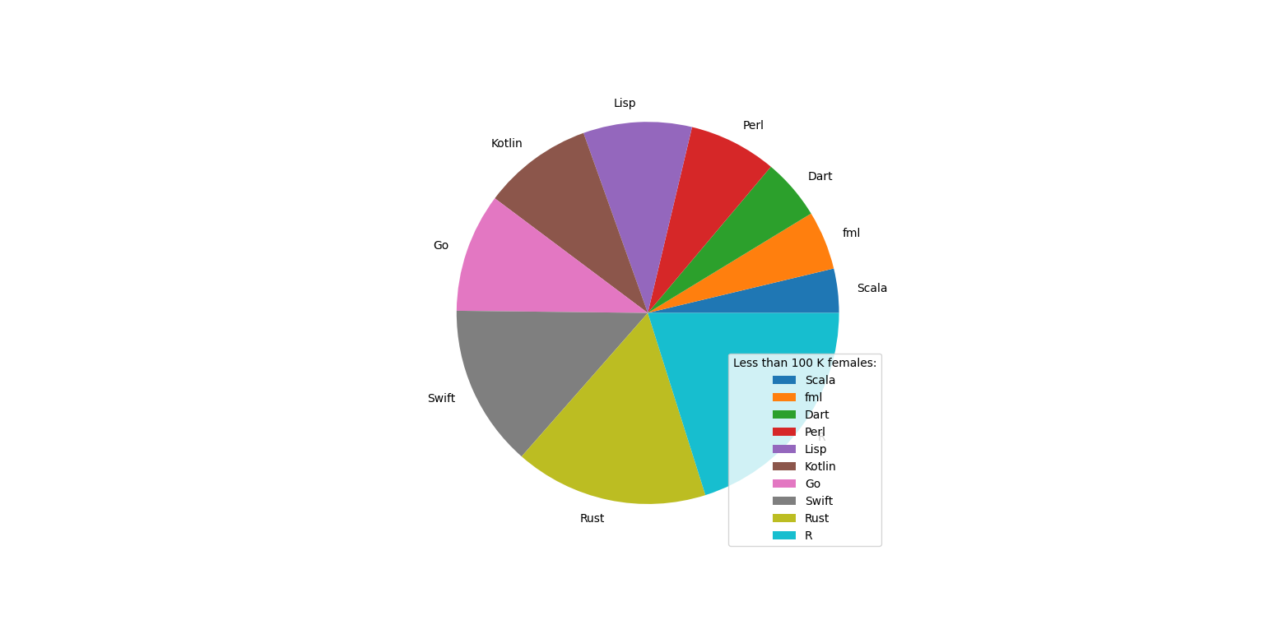
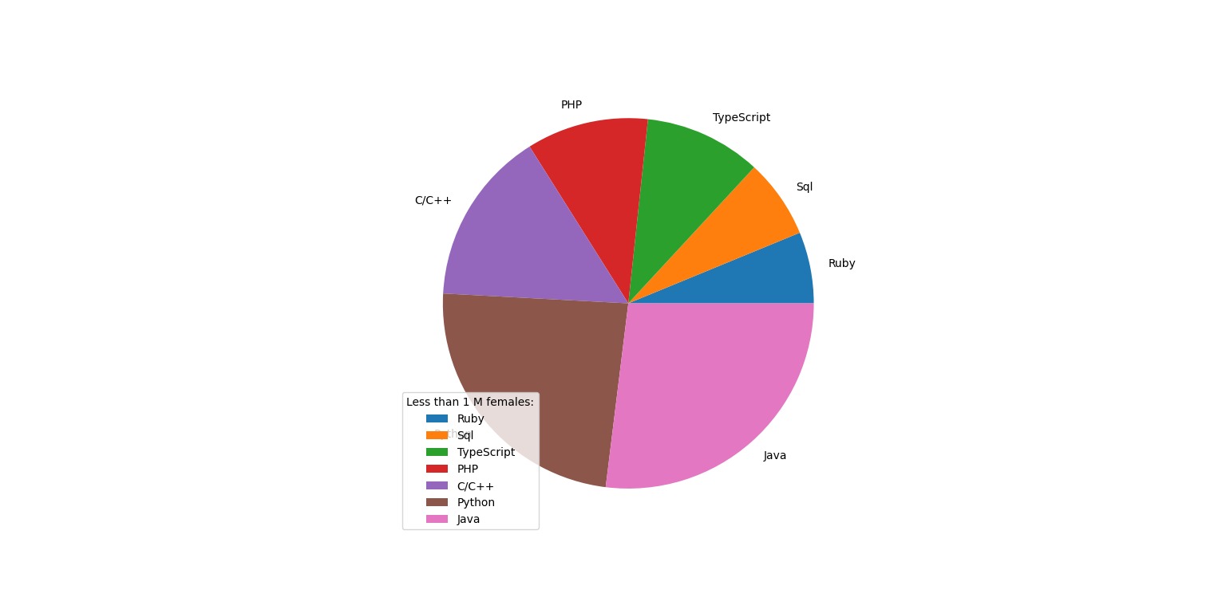
Highly Popular among Females

Slide 10
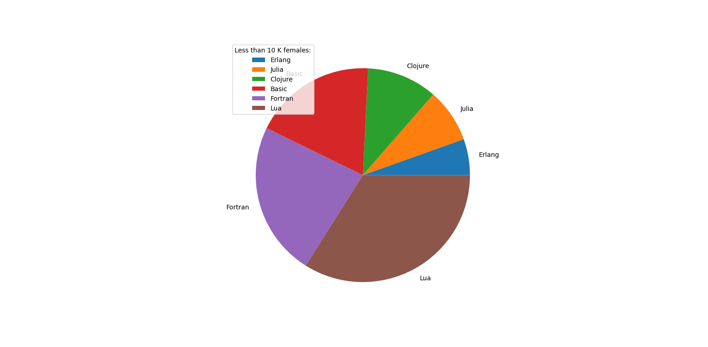
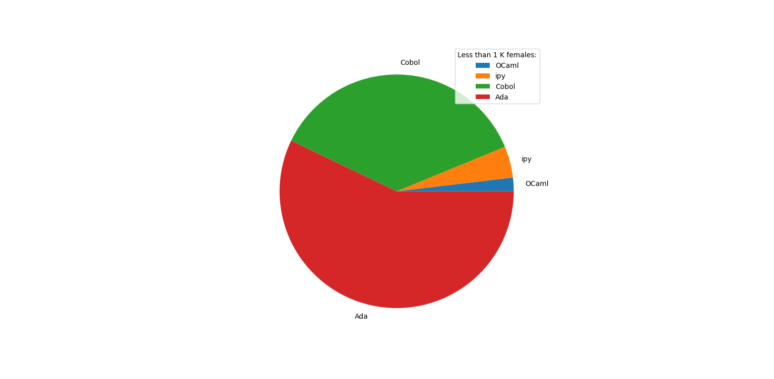
Less Popular among Females

Slide 11

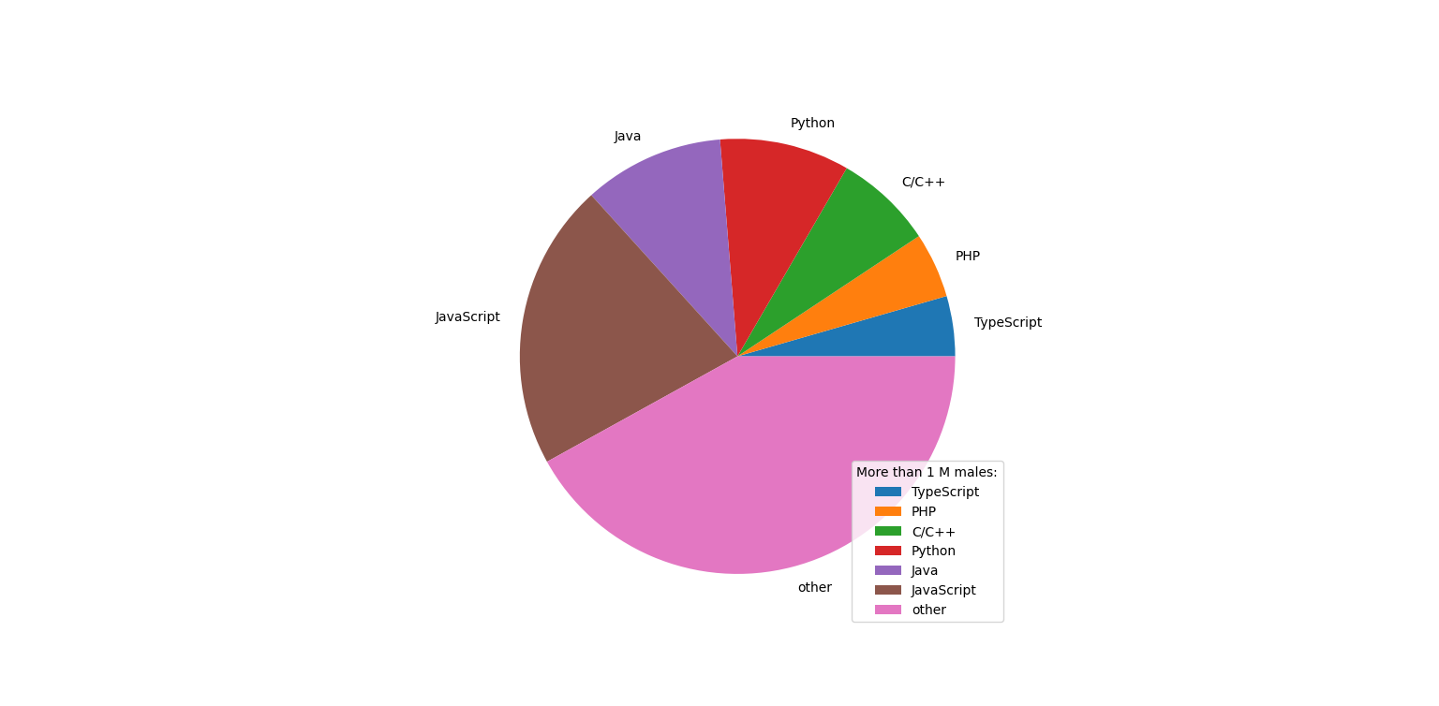
Comparison between males and females (Highly popular)

Slide 12
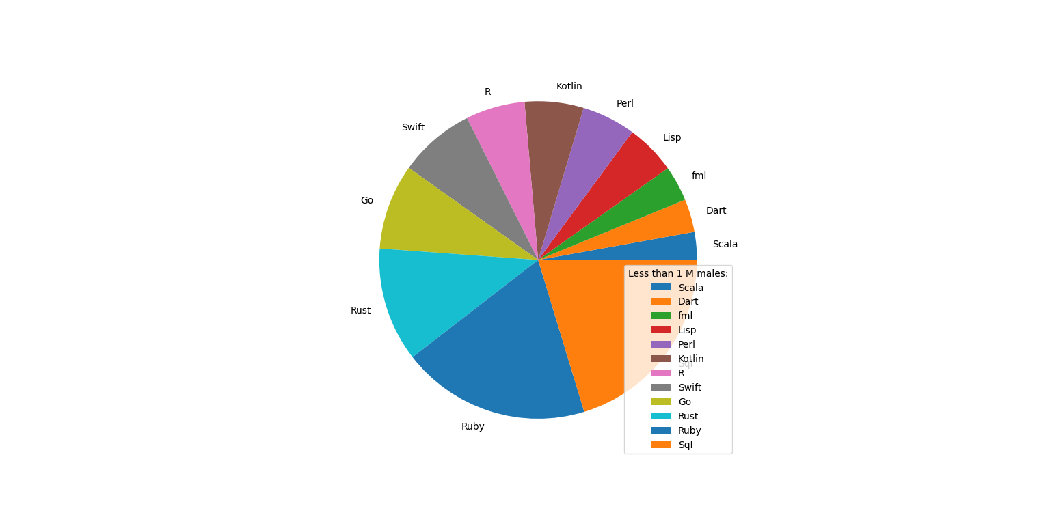
Comparison between males and females (Medium popularity)

Slide 13
Challenges
Segregating projects of the female authors on basis of the areas of work
Find out the trends in the types of projects female authors primarily work on

Slide 14
Work done so far
Listed names and blobs of all the female authors
Identified a set of 1000 female authors to start with
Extracted the base64 encoded README files for these 1000 authors
Decoded the base64 encoded README files to plain text
Ran few basic filters to find out types of projects female authors working on

Slide 15
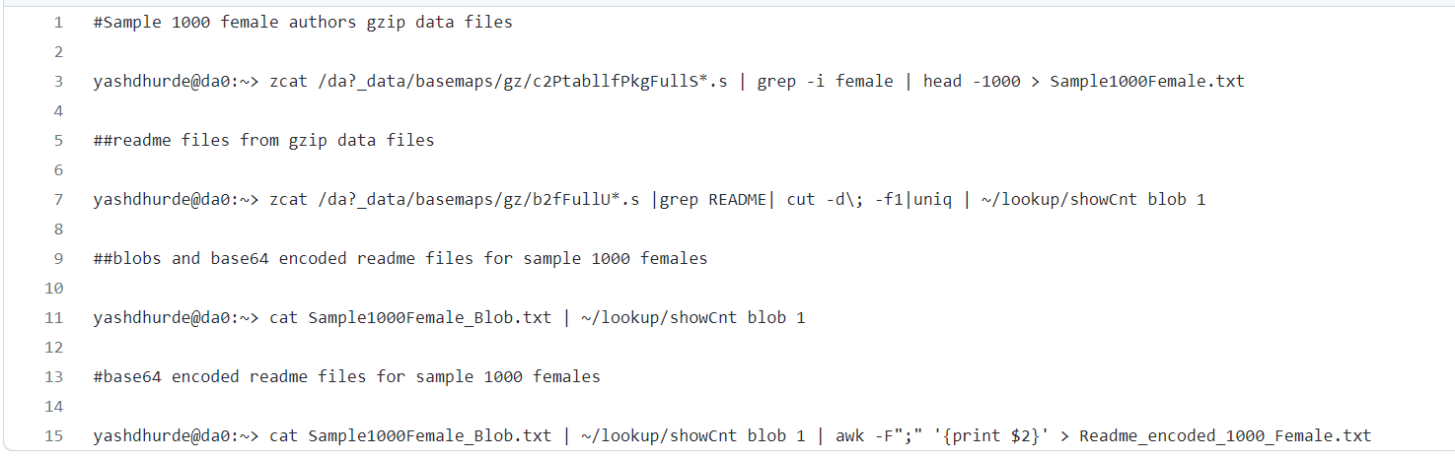
Shell commands to segregate relevant data

Slide 16
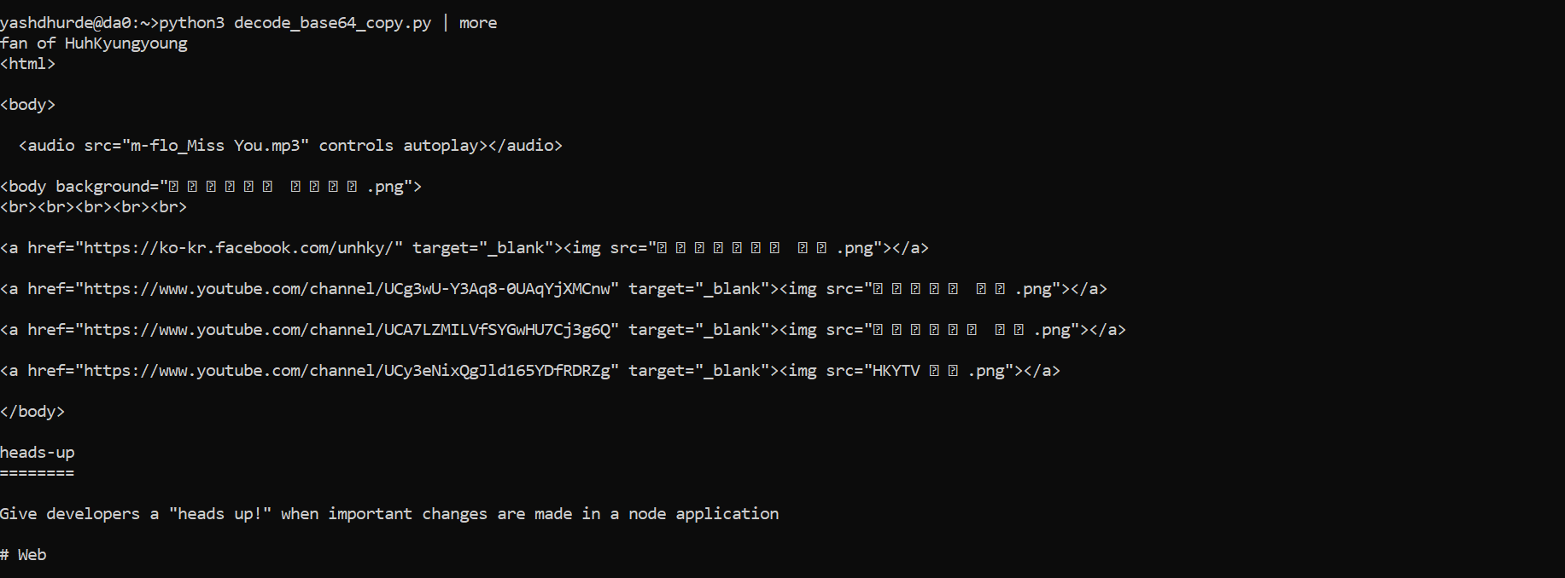
Output of Python Script for Base64 Decoding

Slide 17
Future Work
Work on the Project themes
1
Compare to the themes/Programing language. of interest (hot topics).
2
Work on the 2nd research question:
3
Classify females based on ethnicity (names/location/ time stamp)
Group authors from same location.
Display a heat map of those (numbers/location)

Slide 18
Project Metadata sample
mongos> db.P_metadata.U.findOne({'Gender.female':{ $gt: 1}})
{
"_id" : ObjectId("629018a88b2efbc6e39f5569"),
"FileInfo" : {
"other" : 50,
"JavaScript" : 13
},
"NumAuthors" : 2,
"NumActiveMon" : 1,
"EarliestCommitDate" : 1550806380,
"Gender" : {
"female" : 2
},
"NumBlobs" : 67,
"ProjectID" : "PingPingE_Secure",
"MonNcmt" : {
"2019-02" : 21
},
"MonNauth" : {
"2019-02" : 2
},
"LatestCommitDate" : 1550853660,
"NumCore" : 2,
"NumFiles" : 63,
"CommunitySize" : 1,
"NumCommits" : 21,
"NumForks" : 0,
"Core" : {
"unknown <ds03023@gmail.com>" : "5",
"PingPingE <47843060+PingPingE@users.noreply.github.com>" : "16"
}
}

Slide 19
Project Metadata Versions
mongos> db.P_metadata.U.count()
107936842 ( U Version)
mongos> db.P_metadata.U1.count()
100 (U1 Version)
mongos> db.P_metadata.U2.count()
10 (U2 Version)

Slide 20
Project Metadata Gender Distinct Values
mongos> db.P_metadata.U2.distinct("Gender")
[ { "male" : 1 }, { "male" : 2 } ]
mongos> db.P_metadata.U1.distinct("Gender")
[
{
"female" : 1
},
{
"female" : 1,
"male" : 1
},
{
"female" : 1,
"male" : 2
},
{
"female" : 1,
"male" : 3
},
{
"female" : 2
},
{
"female" : 2,
"male" : 1
},
{
"male" : 1
},
{
"male" : 2
},
{
"male" : 3
}
]

Slide 21
Female Distribution based on Project Metadata
mongos>mongos> db.P_metadata.U.distinct("Gender.female")
[
1,
2,
3,
4,
5,
6,
7,
8,
9,
10,
11,
12,
13,
14,
15,
16,
17,
18,
19,
20,
21,
22,
23,
24,
25,
26,
27,
28,
29,
30,
31,
32,
33,
34,
35,
36,
37,
38,
39,
40,
41,
42,
43,
44,
45,
46,
47,
48,
49,
50,
51,
52,
53,
54,
55,
56,
57,
58,
59,
60,
61,
62,
63,
64,
65,
66,
67,
68,
69,
70,
71,
72,
73,
74,
75,
76,
77,
78,
79,
80,
81,
82,
83,
84,
85,
86,
87,
88,
89,
90,
91,
92,
93,
94,
95,
96,
97,
98,
99,
100,
101,
102,
103,
104,
105,
106,
107,
108,
109,
110,
111,
112,
113,
114,
115,
116,
117,
118,
119,
120,
121,
122,
123,
124,
125,
126,
127,
128,
129,
130,
131,
132,
133,
134,
135,
136,
137,
138,
139,
140,
141,
142,
143,
144,
145,
146,
147,
148,
149,
150,
151,
152,
153,
154,
155,
156,
157,
158,
159,
160,
161,
162,
163,
164,
165,
166,
167,
168,
169,
170,
171,
172,
173,
174,
175,
176,
177,
178,
179,
180,
181,
182,
183,
184,
185,
186,
187,
188,
189,
190,
191,
192,
193,
194,
195,
196,
197,
198,
199,
200,
201,
202,
203,
204,
205,
206,
207,
208,
209,
210,
211,
212,
213,
214,
215,
216,
217,
218,
219,
220,
221,
222,
223,
224,
225,
226,
227,
228,
229,
230,
231,
232,
233,
234,
235,
236,
237,
238,
239,
240,
241,
242,
243,
244,
245,
246,
247,
248,
249,
250,
251,
252,
253,
255,
257,
259,
260,
262,
263,
264,
265,
266,
267,
268,
269,
271,
272,
273,
275,
277,
278,
279,
280,
282,
283,
285,
286,
287,
288,
289,
290,
292,
294,
295,
296,
297,
300,
301,
302,
303,
304,
305,
306,
307,
308,
309,
310,
311,
313,
314,
315,
316,
317,
319,
320,
321,
322,
323,
325,
327,
328,
329,
332,
333,
334,
336,
338,
340,
341,
342,
343,
346,
347,
348,
349,
350,
351,
352,
353,
354,
357,
358,
359,
361,
362,
366,
367,
370,
371,
372,
374,
375,
376,
377,
378,
379,
380,
381,
382,
385,
386,
387,
388,
390,
391,
393,
395,
397,
399,
400,
401,
404,
406,
409,
410,
411,
....
]

